Slide 1
Exploratory Data Analysis
Elif Kır
Hasan Alperen Tosun
Ufuk Secilmiş
Taha Bayaz
EC 48W Data Driven Financial Application

Slide 2
DATA
Data are collected from Kickstarter Platform.
Columns are follows as:
Columns
ID internal kickstarter id
name name of project - A project is a finite work with a clear goal that you’d like to bring to life. Think albums, books, or films.
category category
main_category category of campaign
currency currency used to support
deadline deadline for crowdfunding
goal fundraising goal - The funding goal is the amount of money that a creator needs to complete their project.
launched date launched
pledged amount pledged by "crowd"
state Current condition the project is in
backers number of backers
country country pledged from
usd pledged Pledged amount in USD (conversion made by KS)
usd_pledged_real Pledged amount in USD (conversion made by fixer.io api)
usd_goal_real Goal amount in USD

Slide 3
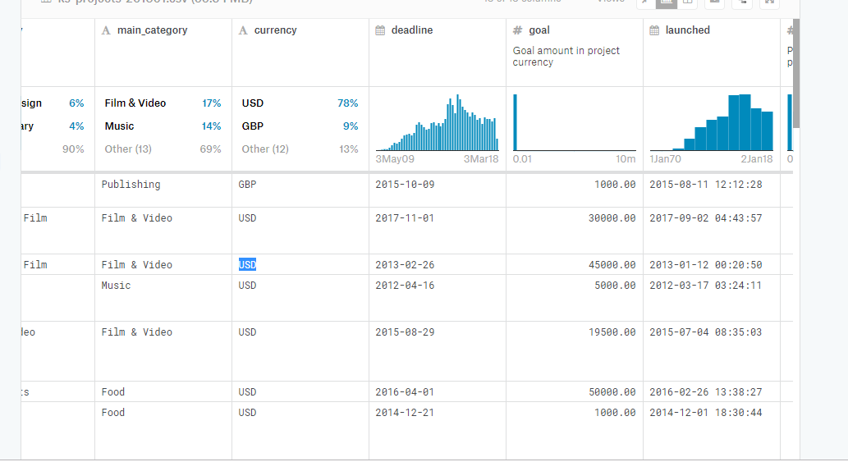
DATA
The data consists of 379 million rows and 15 columns.

Slide 4
Methadology: Classification
Question?
Can we predict wether startup is successful or failed?
The data contain a column which is called as state. To make a feasible prediction we eliminated other types of states rather than successful and failed.
Then,we got rid of irrelavant columns such as country and ID.
To avoid a bias in prices, we just took into real prices into account.

Slide 5
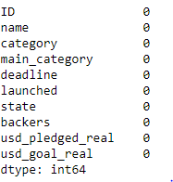
After cleaning the data we get this data set without any null values;

Slide 6
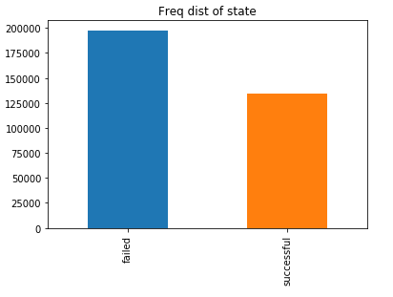
STATISTICAL EXPLORATION OF FEATURES

Slide 7
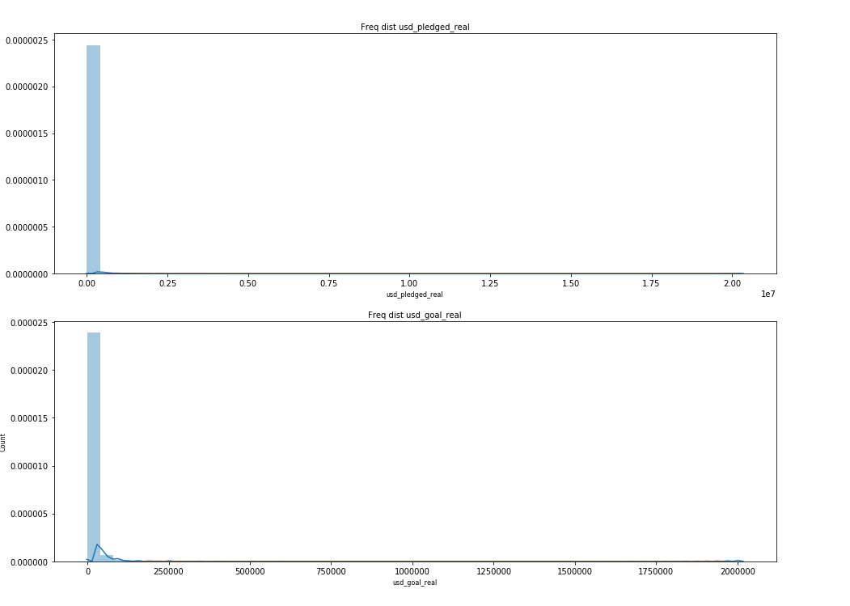
Frequency distribution of the columns ‘usd_pledged_real’ and ‘usd_goal_real’

Slide 8
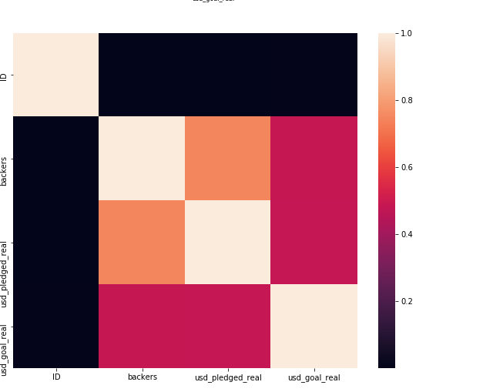
Heatmap of the data

Slide 9
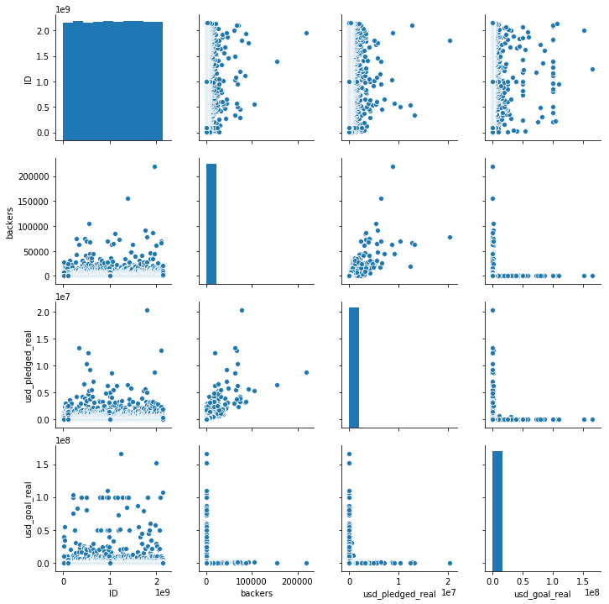
Pairplot of the data

